Slide 1
Entity Framework Debugging using SQL Server
A Detective Story

Slide 2


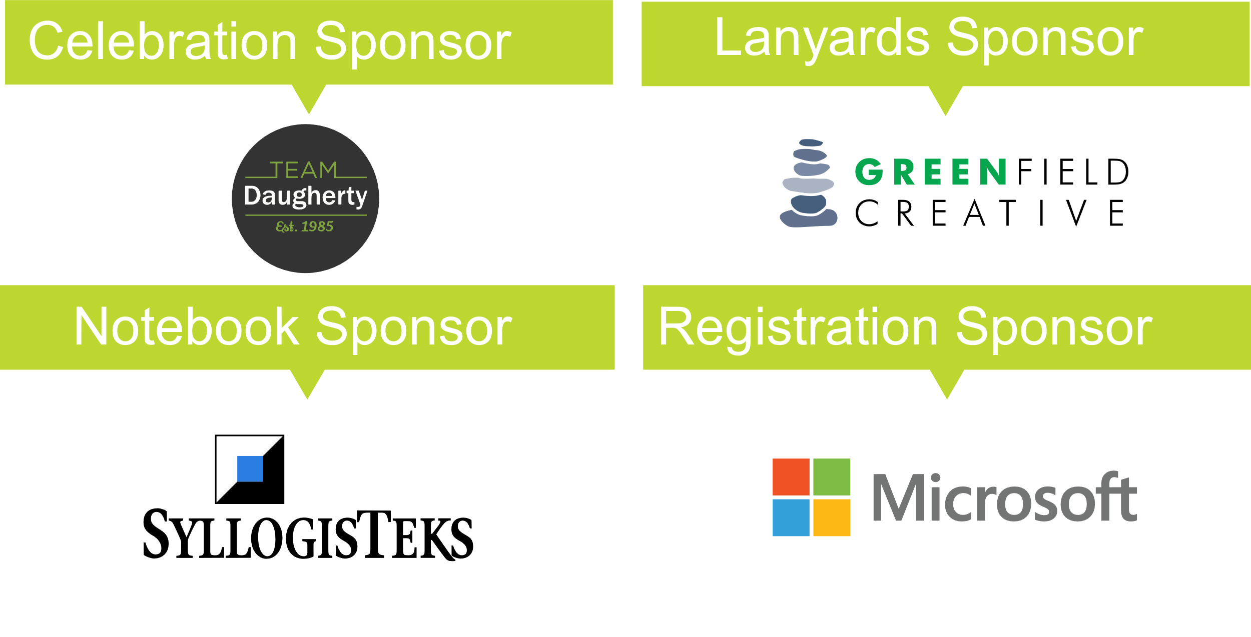


Slide 3

Story

Slide 4

Hello
Chris Woodruff

Slide 5
I am not a dba!

Slide 6

We are not going to attack DBA’s Here!

Slide 7

What we want to solve?

Slide 8


Goals for this talk!
Better use of the tools for SQL Server
Better use of Entity Framework Core for performance and happier users
Better relationship with your DBA’s!

Slide 9
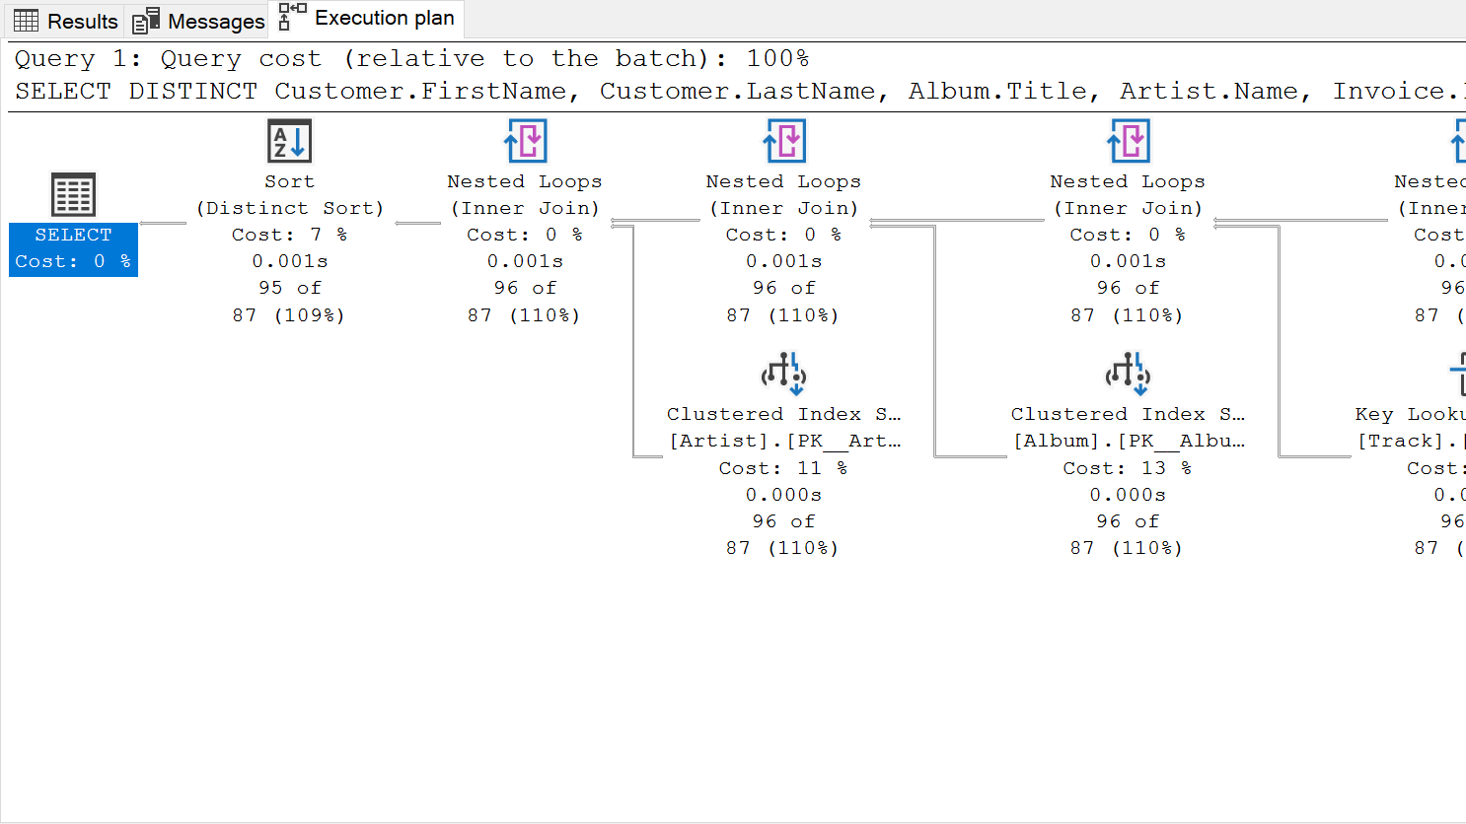
Detective Tip #1 – understand query Plans

Slide 10
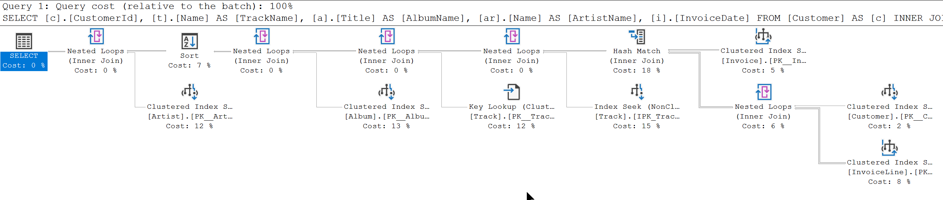
SELECT c.CustomerId, t.Name AS TrackName, a.Title AS AlbumName, ar.Name AS ArtistName, i.InvoiceDate
FROM Customer AS c
INNER JOIN Invoice AS i ON c.CustomerId = i.CustomerId
INNER JOIN InvoiceLine AS il ON i.InvoiceId = il.InvoiceId
INNER JOIN Track AS t ON il.TrackId = t.TrackId
INNER JOIN Album AS a ON t.AlbumId = a.AlbumId
INNER JOIN Artist AS ar ON a.ArtistId = ar.ArtistId
WHERE c.CustomerId = 2
ORDER BY AlbumName

Slide 11
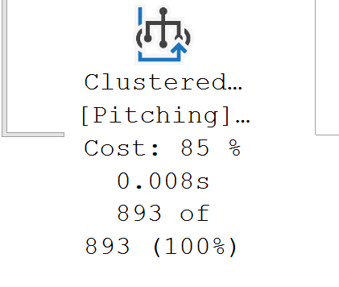
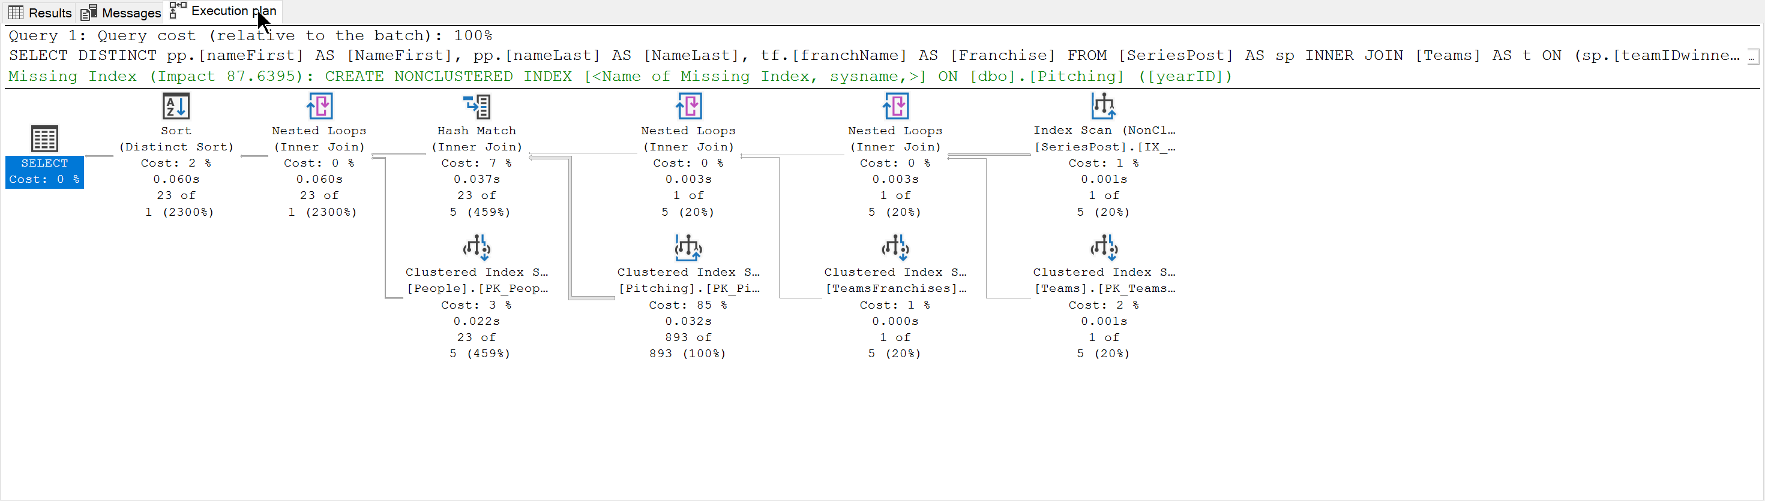
SELECT DISTINCT pp.[nameFirst] AS [NameFirst], pp.[nameLast] AS [NameLast], tf.[franchName] AS [Franchise]
FROM [SeriesPost] AS sp
INNER JOIN [Teams] AS t
ON (sp.[teamIDwinner] = t.[teamID]) AND (sp.[lgIDwinner] = t.[lgID]) AND (sp.[yearID] = t.[yearID])
INNER JOIN [TeamsFranchises] AS tf
ON t.[franchID] = tf.[franchID]
INNER JOIN [Pitching] AS p
ON (t.[teamID] = p.[teamID]) AND (t.[lgID] = p.[lgID]) AND (t.[yearID] = p.[yearID])
INNER JOIN [People] AS pp
ON p.[playerID] = pp.[playerID]
WHERE (sp.[round] = 'WS') AND (sp.[yearID] = 2018)

Slide 12
Client Statics
Notes:
SSMS can do more than displaying your query results. It has great options to help you when you need to improve your query performances. Client Statics feature is one of these options SSMS comes with. This feature displays all kind of important statistics about your query. It works just like Execution plan option, you need to enable it and run your query to see the results. You can turn it on in couple of way.

Slide 13
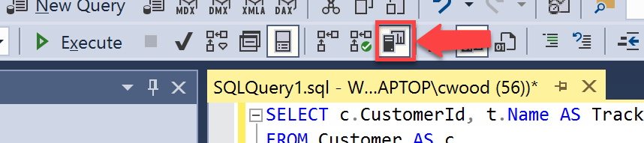
SELECT c.CustomerId, t.Name AS TrackName, a.Title AS AlbumName, ar.Name AS ArtistName, i.InvoiceDate
FROM Customer AS c
INNER JOIN Invoice AS i ON c.CustomerId = i.CustomerId
INNER JOIN InvoiceLine AS il ON i.InvoiceId = il.InvoiceId
INNER JOIN Track AS t ON il.TrackId = t.TrackId
INNER JOIN Album AS a ON t.AlbumId = a.AlbumId
INNER JOIN Artist AS ar ON a.ArtistId = ar.ArtistId
WHERE c.CustomerId = 2
ORDER BY AlbumName
You can press Shift + Alt + S

Slide 14
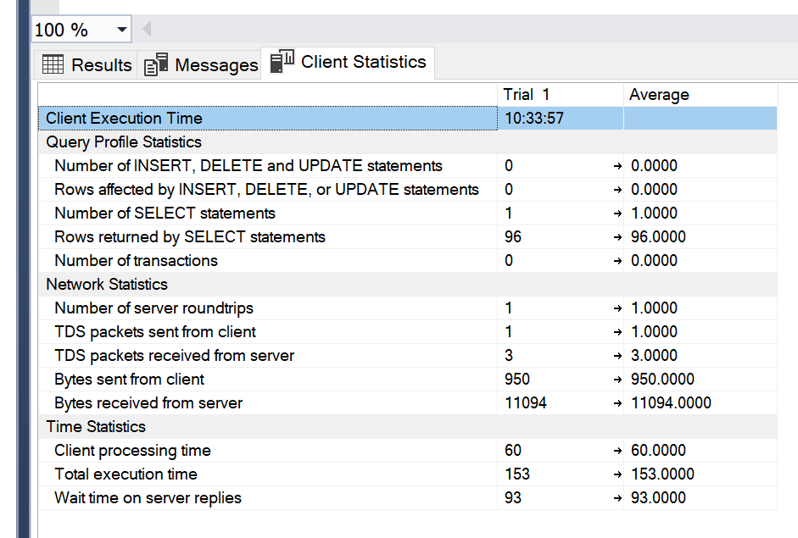
SELECT c.CustomerId, t.Name AS TrackName, a.Title AS AlbumName, ar.Name AS ArtistName, i.InvoiceDate
FROM Customer AS c
INNER JOIN Invoice AS i ON c.CustomerId = i.CustomerId
INNER JOIN InvoiceLine AS il ON i.InvoiceId = il.InvoiceId
INNER JOIN Track AS t ON il.TrackId = t.TrackId
INNER JOIN Album AS a ON t.AlbumId = a.AlbumId
INNER JOIN Artist AS ar ON a.ArtistId = ar.ArtistId
WHERE c.CustomerId = 2
ORDER BY AlbumName
Notes:
Client Statistics Tips All times are in milliseconds. To reset the results click on Menu > Query > Reset Client Statistics You may want clear the query cache by using DBCC DROPCLEANBUFFERS command in your query.

Slide 15

Detective Tip #2 – Query Tags and Extended Events

Slide 16
Query Tags
var albums = _context.Album.Include(a => a.Artist) .TagWith("Description: Query for Albums") .TagWith("Query located: Chinook.Controllers.AlbumsController.Index() method") .TagWith(@"Parameters: None");

Slide 17
Query Tags
-- Description: Query for Albums
-- Query located: Chinook.Controllers.AlbumsController.Index() method
-- Parameters:
-- None
SELECT [a].[AlbumId], [a].[ArtistId],
[a].[Title], [a.Artist].[ArtistId], [a.Artist].[Name]
FROM [Album] AS [a]
INNER JOIN [Artist] AS [a.Artist] ON [a].[ArtistId] = [a.Artist].[ArtistId]

Slide 18
Extended Events
CREATE EVENT SESSION [ChinookAlbumQueries] ON SERVER
ADD EVENT sqlserver.sql_statement_completed(
ACTION(sqlserver.sql_text)
WHERE (
[sqlserver].[like_i_sql_unicode_string]
([sqlserver].[sql_text], N'%SELECT%ALBUM%'))
)
WITH (TRACK_CAUSALITY=ON);

Slide 19
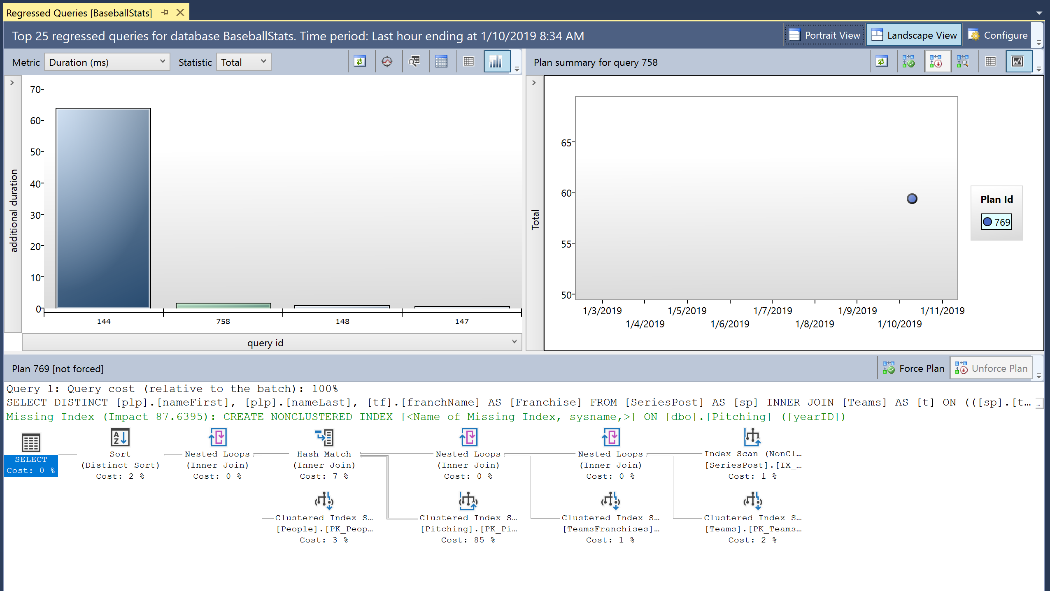
Detective Tip #3 – Learn about Query Store

Slide 20

Understanding the Query Store

Slide 21
Show how to enable Query Store
ALTER DATABASE AdventureWorks2017 SET QUERY_STORE = ON;

Slide 22

Detective Tip #4 – What we can do to improve our EF queries

Slide 23
String interpolation in raw SQL methods
var city = "Redmond";
using (var context = CreateContext())
{
context.Customers.FromSql($@“
SELECT *
FROM Customers
WHERE City = {city}");
}
var city = "Redmond";
using (var context = CreateContext())
{
FormattableString query =
$@“SELECT *
FROM Customers
WHERE City = {city}";
context.Customers.FromSql(query);
}
SELECT *
FROM Customers
WHERE City = @p0

Slide 24
Explicitly Compiled Queries
private static readonly Func<ChinookContext, AsyncEnumerable<Album>> _queryGetAllAlbums = EF.CompileAsyncQuery((ChinookContext db) => db.Album);
public async Task<List<Album>> GetAllAlbumsAsync() => await _queryGetAllAlbums(this).ToListAsync();

Slide 25
DbContext Pooling
DI Container
public class AlbumRepository : IAlbumRepository
{
private MyDBContext _context;
public AlbumRepository(MyDBContext context)
{
_context = context;
}
public async Task<List<Album>> GetAllAsync()
=> await _context.Album.ToListAsync(ct);
}
Request: /blogs/index
Scope
BlogContext
Blogs
Controller
Request: /blogs/index
Scope
BlogContext
Blogs
Controller
Request: /blogs/index
Scope
BlogContext
Blogs
Controller
Notes:
Many ASP.NET Core applications can now obtain a performance boost by configuring the service registration of their DbContext types to use a pool of pre-created instances, avoiding the cost of creating new instance for every request:

Slide 26
DbContext Pooling
DI Container
public class AlbumRepository : IAlbumRepository
{
private MyDBContext _context;
public AlbumRepository(MyDBContext context)
{
_context = context;
}
public async Task<List<Album>> GetAllAsync()
=> await _context.Album.ToListAsync(ct);
}
Request: /blogs/index
Context Pool
Scope
BlogContext
BlogContext
Scope
Blogs
Controller
BlogContext
BlogContext
BlogContext
Request: /blogs/index
BlogContext
BlogContext
Blogs
Controller
Scope
Request: /blogs/index
Scope
BlogContext
Blogs
Controller

Slide 27
DbContext Pooling
services.AddDbContext<BloggingContext>( options => options.UseSqlServer(connectionString));
services.AddDbContextPool<BloggingContext>( options => options.UseSqlServer(connectionString));

Slide 28

Be nice to your DBA!

Slide 29

Wrap Up!

Slide 30
Thanks!!!
cwoodruff@live.com
https://github.com/cwoodruff/DebugEFCoreWithMSSQL

